Slide 1
CF Obesity data – updated October data

Slide 2
Data overview
Data from 145,544 annual reviews of 13,429 individuals aged between 2 – 89, collected between 2007 – 2023.
31,474 child reviews were missing BMI percentile. BMI percentile was calculated using the NHS BMI calculator.
Other variables: age, sex, ethnicity, mutation, FEV1%, number of IV days (home & hospital), supplemental feeding by route (oral, nasogastric, gastronomy, jejunal, parenteral), microbiology (did the patient grow Pseudomonas, Bcenocepacia, Staph.aureus, Aspergillius), is the patient taking pancreatic enzyme supplements, CMPL NTM, employment status (2016 onwards), CFTR history, transplant history (liver, lung, kidney, pancreas).
 |  | Number of annual reviews where…
Year | Number of annual reviews | Person seen for the first time | Person attended last years review | People missed last years review
2007 | 4,232 | 4,232
2008 | 5,766 | 2,128 | 3,638
2009 | 6,985 | 1,225 | 5,334 | 426
2010 | 7,523 | 826 | 6,421 | 276
2011 | 8,204 | 563 | 7,221 | 420
2012 | 8,374 | 467 | 7,752 | 155
2013 | 8,611 | 415 | 8,013 | 183
2014 | 9,027 | 423 | 8,272 | 332
2015 | 9,221 | 414 | 8,624 | 183
2016 | 9,358 | 368 | 8,765 | 225
2017 | 9,544 | 379 | 8,968 | 197
2018 | 9,535 | 355 | 8,981 | 199
2019 | 9,760 | 368 | 9,097 | 295
2020 | 9,458 | 324 | 8,931 | 203
2021 | 9,893 | 323 | 9,045 | 525
2022 | 9,984 | 306 | 9,299 | 379
2023 | 10,069 | 313 | 9,322 | 434

Slide 3
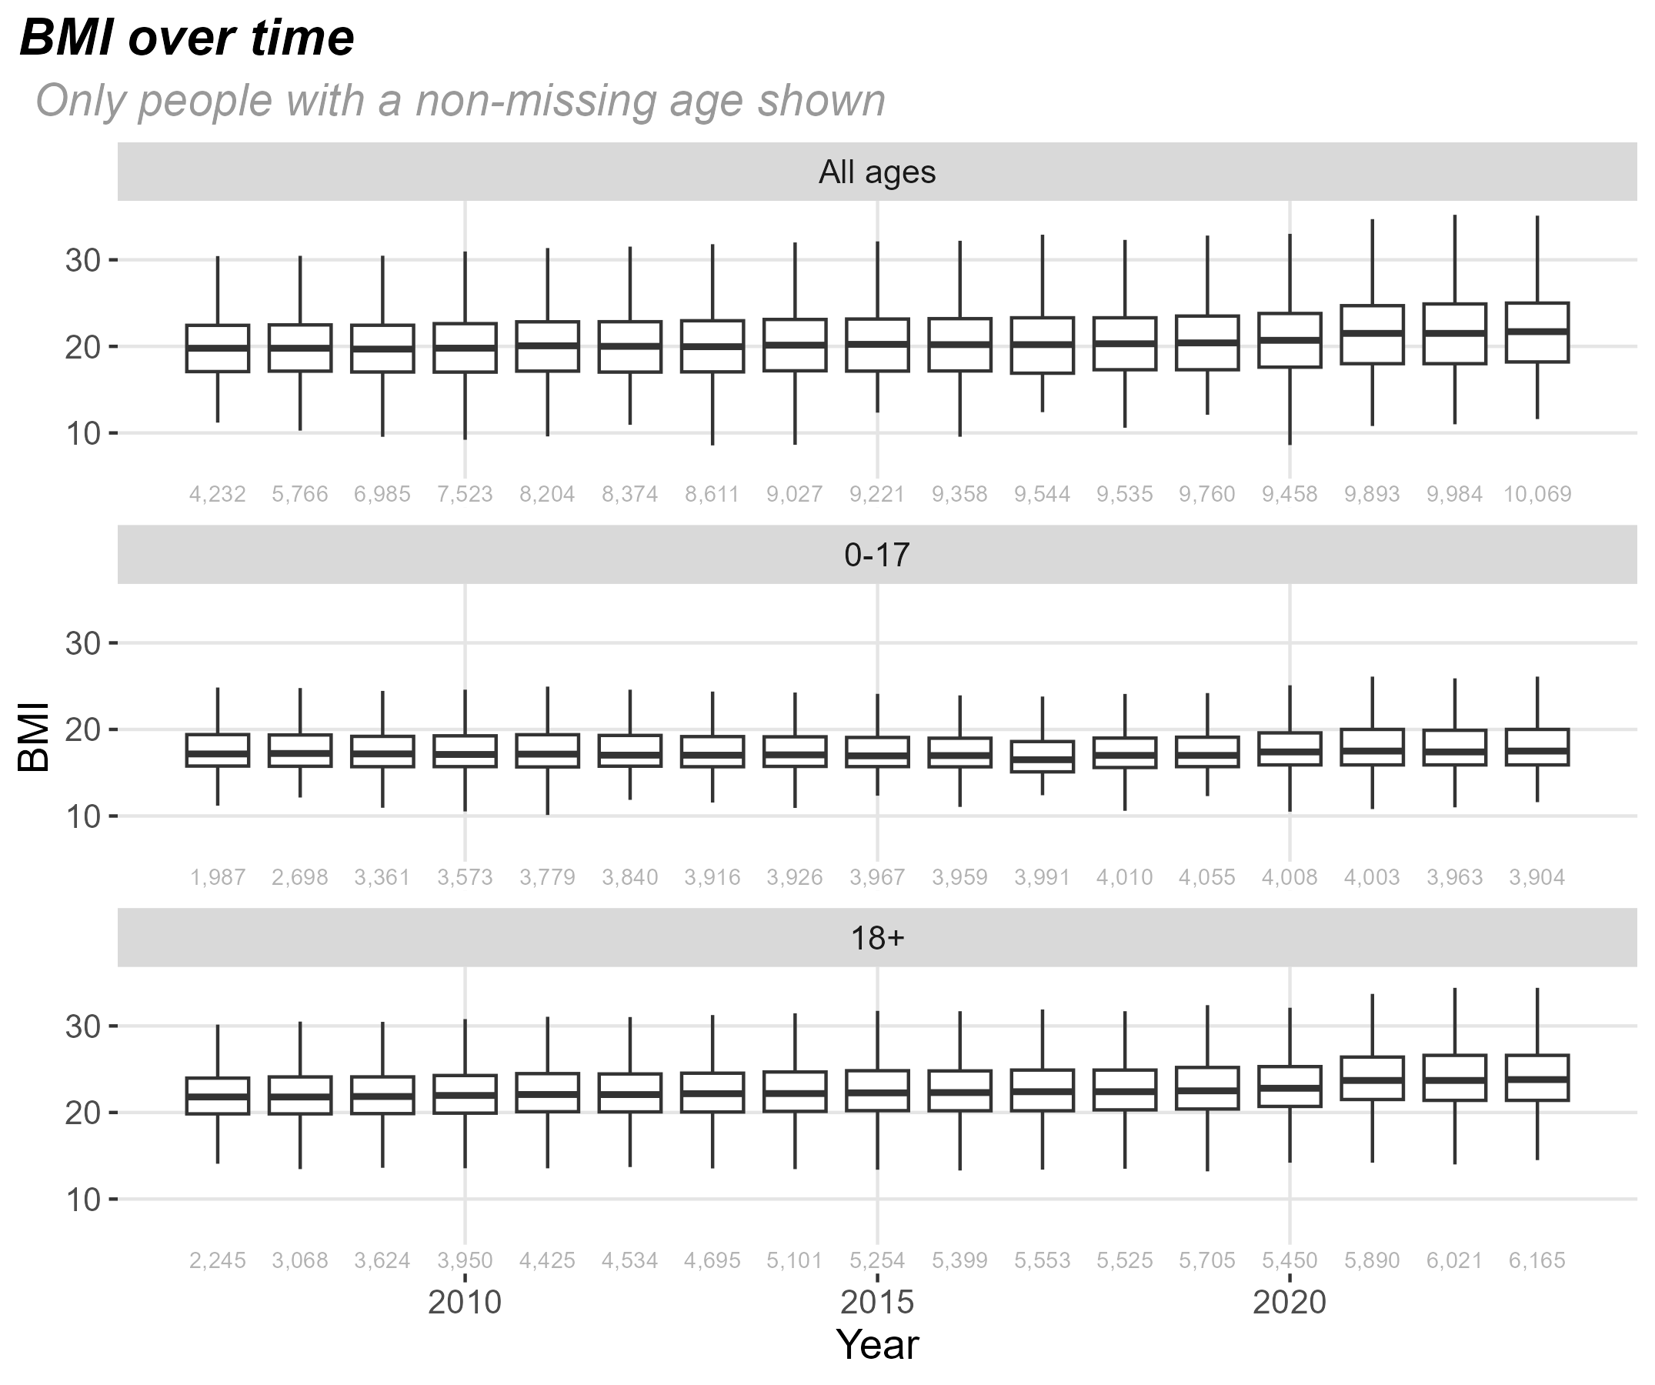
BMI trends
For each year the thick line is the median BMI, 50% of the data is between the upper & lower lines of the box, and roughly 95% of the data is between the whiskers
BMI has gradually increased since 2018. The increase has happened in both adults & children

Slide 4
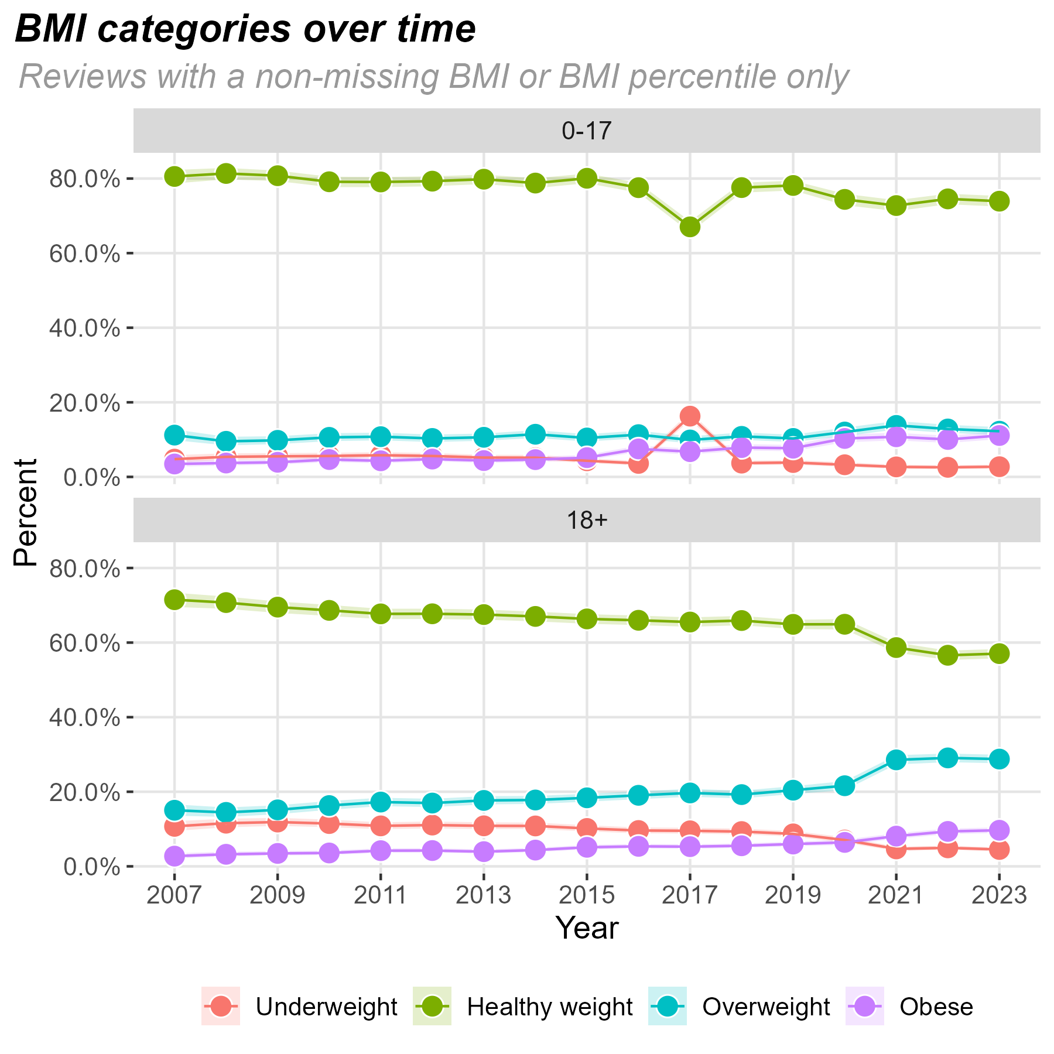
BMI groups – by age
Each point is the proportion of people in each weight group, the lighter line shows the uncertainty around the estimate. The more people in the group, the smaller the uncertainty
Adults have seen large increases in the proportion who are overweight or obese. There are also increases in children, but these are much smaller

Slide 5
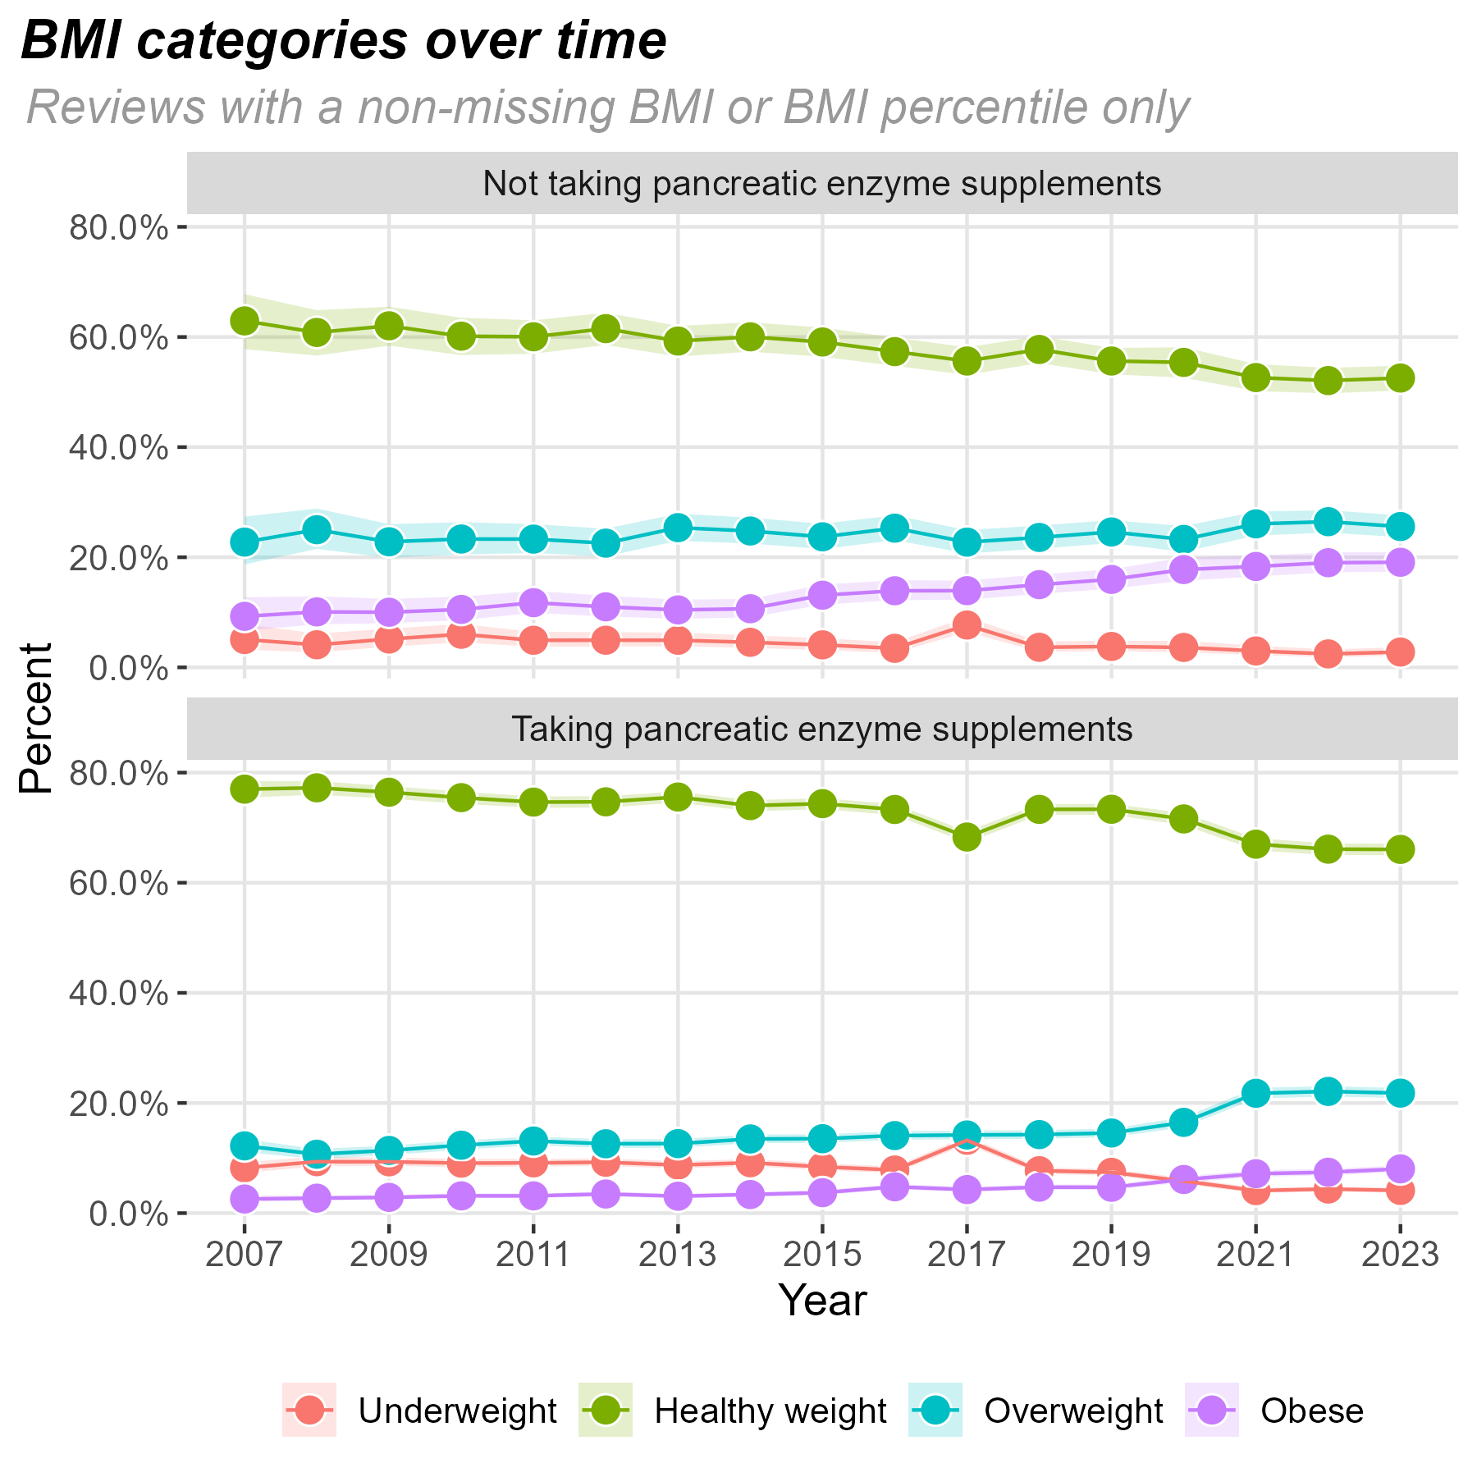
BMI groups – by pancreas supplement
People receiving pancreas supplements have a much smaller increase in the proportion who are obese compared to people not receiving supplements

Slide 6
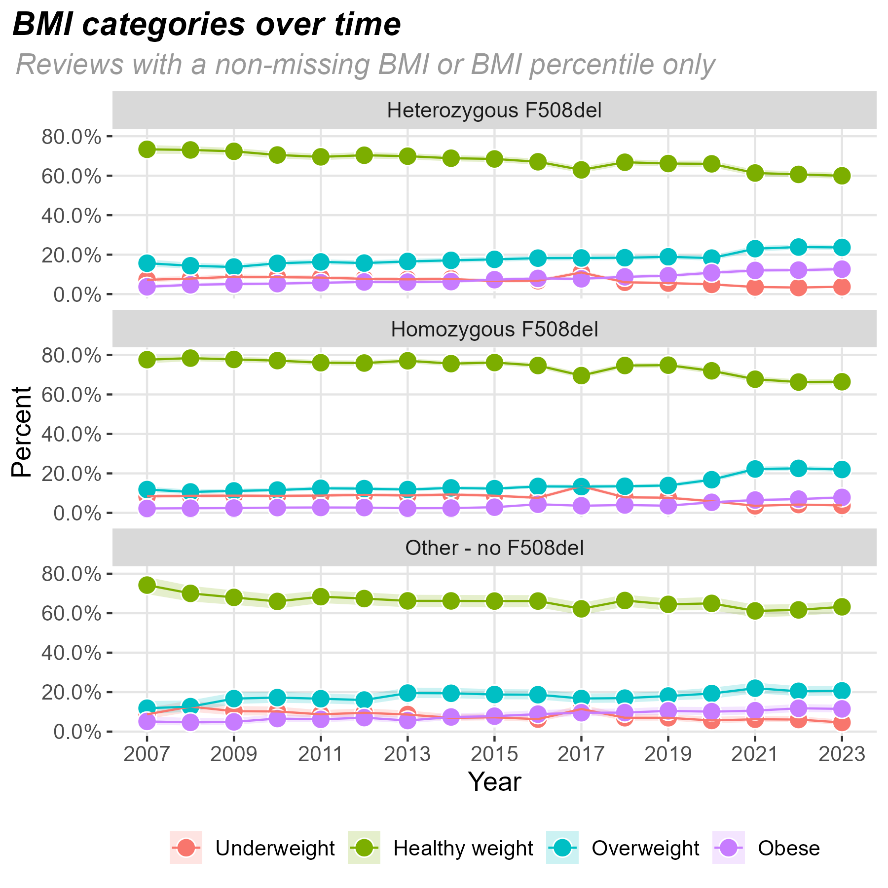
BMI groups – by mutation group
Similar trends across mutation groups – increases in overweight and slight increase in obese groups from 2020.
The increases are less pronounced in the no F508del group.

Slide 7
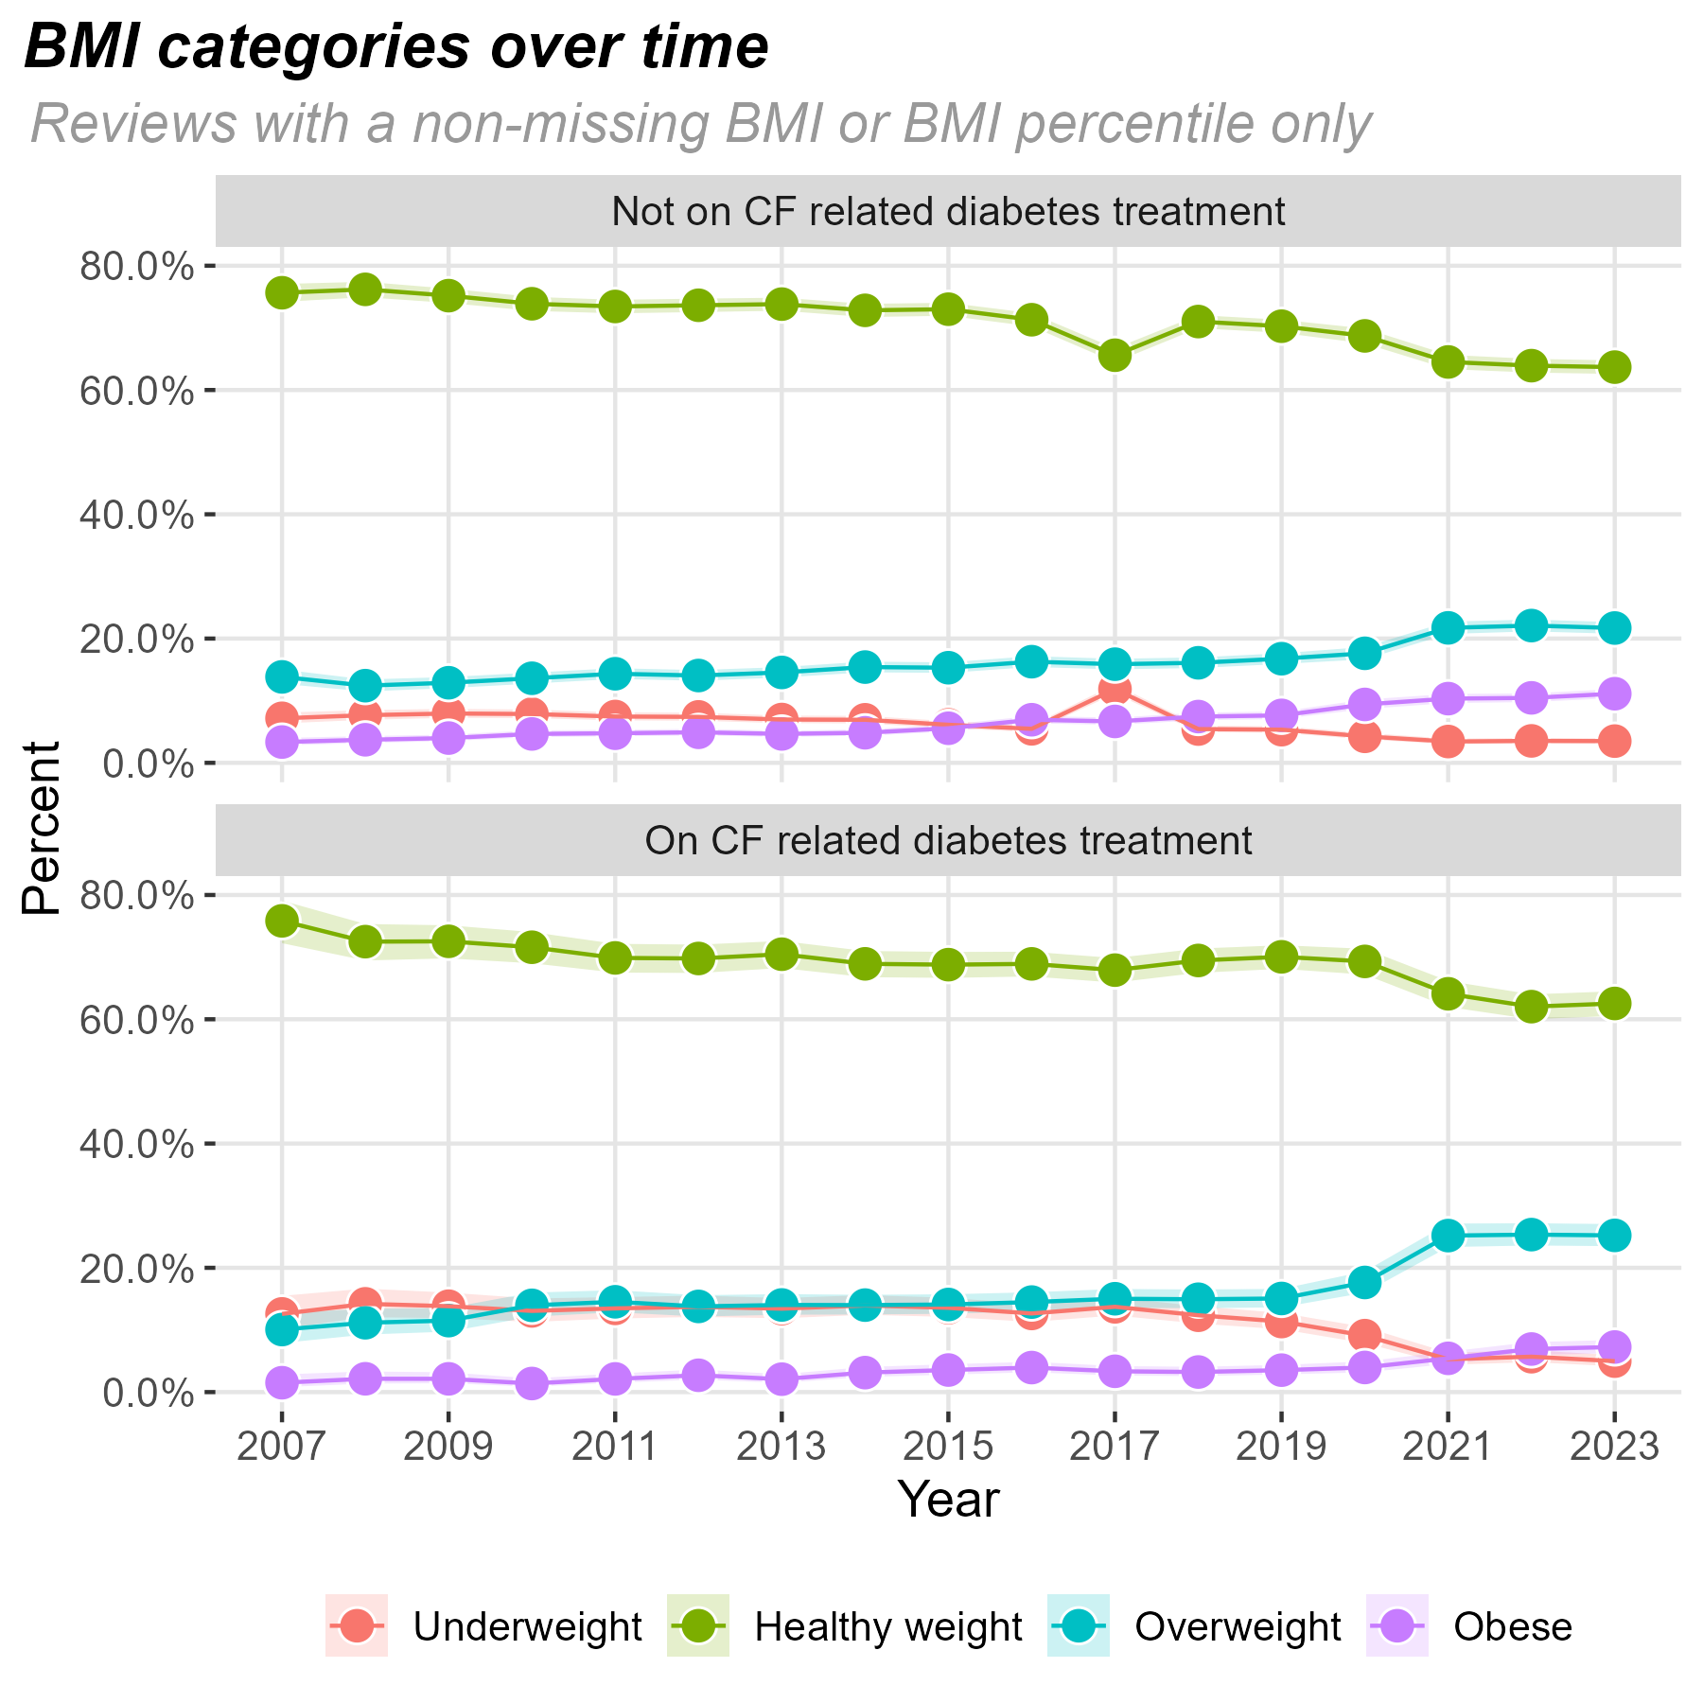
BMI groups – by CF related diabetes
Note: CFRD diagnosis data only available from 2016 onwards. This looks at if the person was on any treatment for CFRD.
Larger increase in the overweight group in people being treated for CFRD.

